Slide 1
Developing Node.js web applications

Slide 2
Developing Node.js web applications
Node.js is a platform that supports various types of application, but the most popular kind is the development of web applications.
Node's style of coding depends on the community to extend the platform through third-party modules.
These modules are then built upon to create new modules, and so on.
Companies and single developers around the globe are participating in this process by creating modules that wrap the basic Node APIs and deliver a better starting point for application development.

Slide 3
Developing Node.js web applications (continued)
There are many modules to support web application development, but none as popular as the Connect module.
The Connect module delivers a set of wrappers around the Node.js low-level APIs to enable the development of rich web application frameworks.

Slide 4
Developing Node.js web applications (continued)
To understand what Connect is all about, let's begin with a basic example of a basic Node web server.
In your working folder, create a file named server.js that contains the following code snippet:
const http = require('http');
http.createServer((req, res) => {
res.writeHead(200, {
'Content-Type': 'text/plain'
});
res.end('Hello World');
}).listen(3000);
console.log('Server running at http://localhost:3000/');

Slide 5
Developing Node.js web applications (continued)
To start your web server, use your command-line tool and navigate to your working folder.
Then, run the Node.js CLI tool and run the server.js file as follows:
$ node server
Now, open http://localhost:3000 in your browser and you'll see the Hello World response.
In this example, the http module is used to create a small web server listening to the 3000 port.
You begin by requiring the http module and then use the createServer() method to return a new server object.
The listen() method is then used to listen to the 3000 port.
Notice the callback function that is passed as an argument to the createServer() method.

Slide 6
Meet the Connect module

Slide 7
Meet the Connect module
Connect is a module built to support the interception of requests in a more modular approach.
In the first web server example, you learned how to build a simple web server using the http module.
If you wish to extend this example, you'd have to write code that manages the different HTTP requests sent to your server, handles them properly, and provides the correct response to each request.
Connect creates an API exactly for that purpose.

Slide 8
Meet the Connect module (continued)
Connect uses a modular component called middleware, which allows you to simply register your application logic to predefined HTTP request scenarios.
Connect middlewares are basically callback functions, which get executed when an HTTP request occurs.
The middleware can then perform some logic, return a response, or call the next registered middleware.
While you will mostly write custom middleware to support your application needs, Connect also includes some common middleware to support logging, static file serving, and more.
The way a Connect application works is using an object called dispatcher.

Slide 9
Meet the Connect module (continued)
The dispatcher object handles each HTTP request received by the server and then decides the order of middleware execution in a cascading form.
To understand Connect better, take a look at the following diagram:

Slide 10
Meet the Connect module (continued)
The preceding diagram illustrates two calls made to the Connect application: the first is handled by a custom middleware and the second is handled by the static files middleware.
Connect's dispatcher initiates the process, moving on to the next handler using the next() method, until it gets to a middleware responding with the res.end() method, which will end the request handling.
In the next Lesson, you'll create your first Express application, but Express is based on Connect's approach.
So, in order to understand how Express works, we'll begin by creating a Connect application.

Slide 11
Meet the Connect module (continued)
In your working folder, create a file named server.js that contains the following code snippet:
const connect = require('connect');
const app = connect();
app.listen(3000);
console.log('Server running at http://localhost:3000/');
As you can see, your application file is using the connect module to create a new web server.
However, Connect isn't a core module, so you'll have to install it using npm.
As you already know, there are several ways of installing third-party modules.
The easiest one is to install it directly using the npm install command.

Slide 12
Meet the Connect module (continued)
In your working folder, create a file named server.js that contains the following code snippet:
const connect = require('connect');
const app = connect();
app.listen(3000);
console.log('Server running at http://localhost:3000/');
As you can see, your application file is using the connect module to create a new web server.
However, Connect isn't a core module, so you'll have to install it using npm.
As you already know, there are several ways of installing third-party modules.
The easiest one is to install it directly using the npm install command.

Slide 13
Connect middleware
Connect middleware is basically a JavaScript function with a unique signature.
Each middleware function is defined with the following three arguments:
req: This is an object that holds the HTTP request information
res: This is an object that holds the HTTP response information and allows you to set the response properties
next: This is the next middleware function defined in the ordered set of Connect middleware

Slide 14
Connect middleware (continued)
When you have a middleware defined, you'll just have to register it with the Connect application using the app.use() method.
Let's revise the previous example to include your first middleware. Change your server.js file to look like the following code snippet:
const connect = require('connect');
const app = connect();
function helloWorld(req, res, next) {
res.setHeader('Content-Type', 'text/plain');
res.end('Hello World');
};
app.use(helloWorld);
app.listen(3000);
console.log('Server running at http://localhost:3000/');

Slide 15
Mounting Connect middleware
As you may have noticed, the middleware you registered responds to any request, regardless of the request path.
This does not comply with modern web application development because responding to different paths is an integral part of all web applications.
Fortunately, Connect middleware supports a feature called mounting, which enables you to determine which request path is required for the middleware function to get executed.
Mounting is done by adding the path argument to the app.use() method.

Slide 16
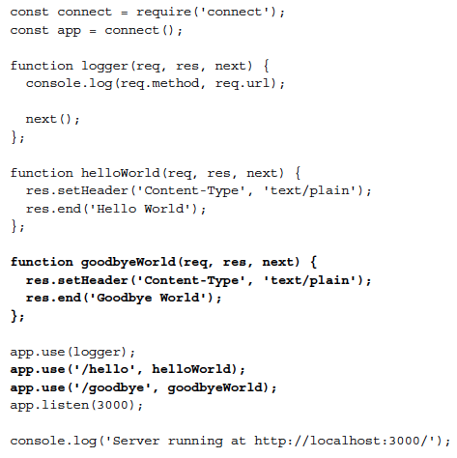
Mounting Connect middleware (continued)
To understand this better, let's revisit our previous example. Modify your server.js file to look like the following code snippet:

Slide 17
Mounting Connect middleware (continued)
A few things have been changed in the previous example.
First, you mounted the helloWorld() middleware to respond only to requests made to the /hello path.
Then, you added another (a bit morbid) middleware called goodbyeWorld() that will respond to requests made to the /goodbye path.
Notice how, as a logger should do, we left the logger() middleware to respond to all the requests made to the server.
Another thing you should be aware of is that any requests made to the base path will not be responded to by any middleware because we mounted the helloWorld() middleware to a specific path.

Slide 18
Mounting Connect middleware (continued)
Connect is a great module that supports various features of common web applications.
Connect middleware is super simple, as it is built with a JavaScript style in mind.
It allows the endless extension of your application logic without breaking the nimble philosophy of the Node platform.

Slide 19
Mounting Connect middleware (continued)
While Connect is a great improvement over writing your web application infrastructure, it deliberately lacks some basic features you're used to having in other web frameworks.
The reason lies in one of the basic principles of the Node community: create your modules lean and let other developers build their modules on top of the module you created.
The community is supposed to extend Connect with its own modules and create its own web infrastructures.
In fact, one very energetic developer named TJ Holowaychuk did it better than most when he released a Connect-based web framework known as Express.

